Slide 1


Preparing for Einstein Telescope: GPU-native scientific computing without compromises
Thibeau Wouters
Advanced Computing User Day 2025

Slide 2
10 years ago…
Something exciting happened
Notes:
https://event.surf.nl/national-accelerated-computing-workshop/

Slide 3
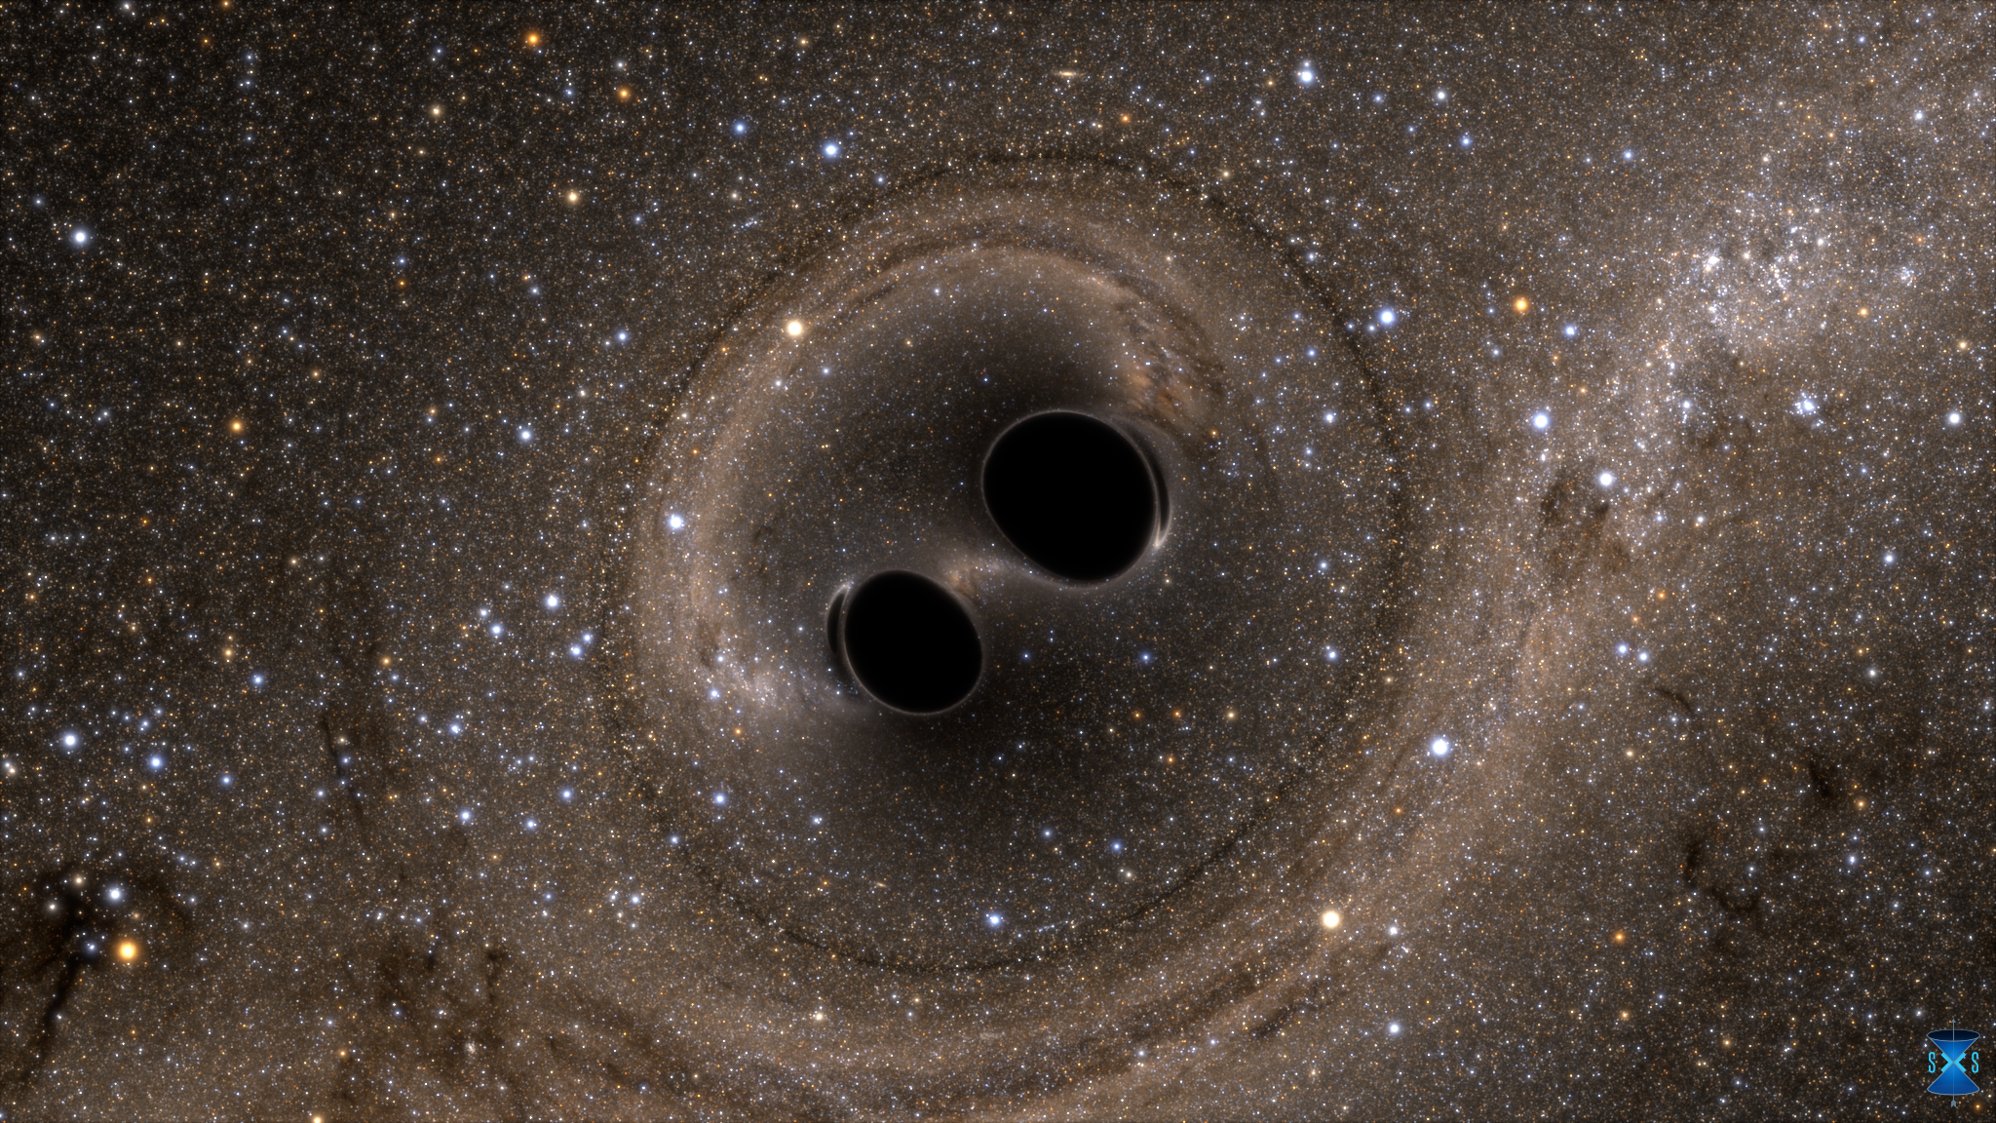
1.3 billion years before that…
Notes:
https://www.youtube.com/watch?v=I_88S8DWbcU&t=1s

Slide 4
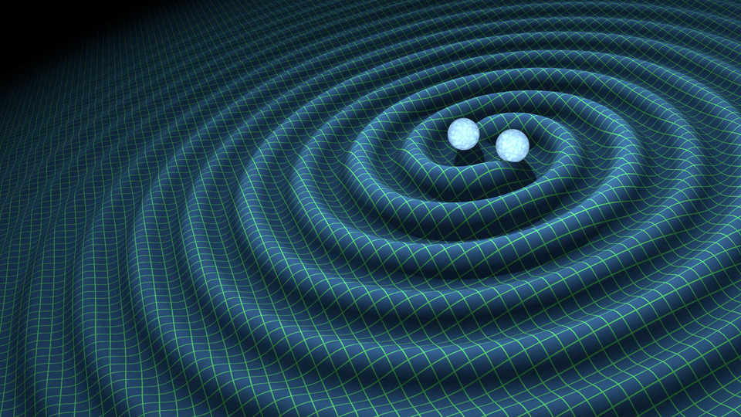
Gravitational waves

Slide 5
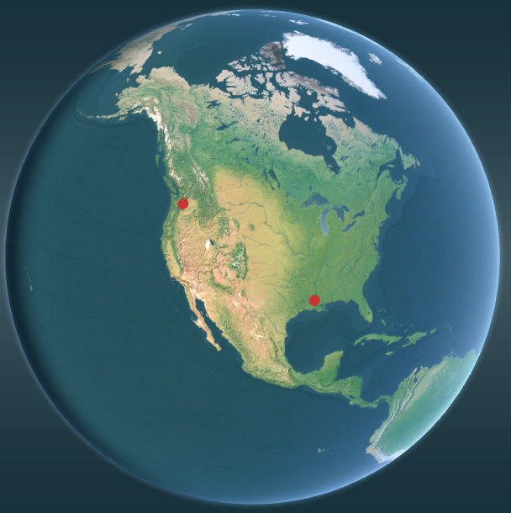
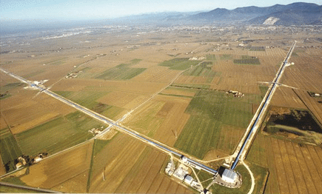
10 years ago, Earth listened
LIGO
Notes:
https://www.youtube.com/watch?v=I_88S8DWbcU&t=1s

Slide 6
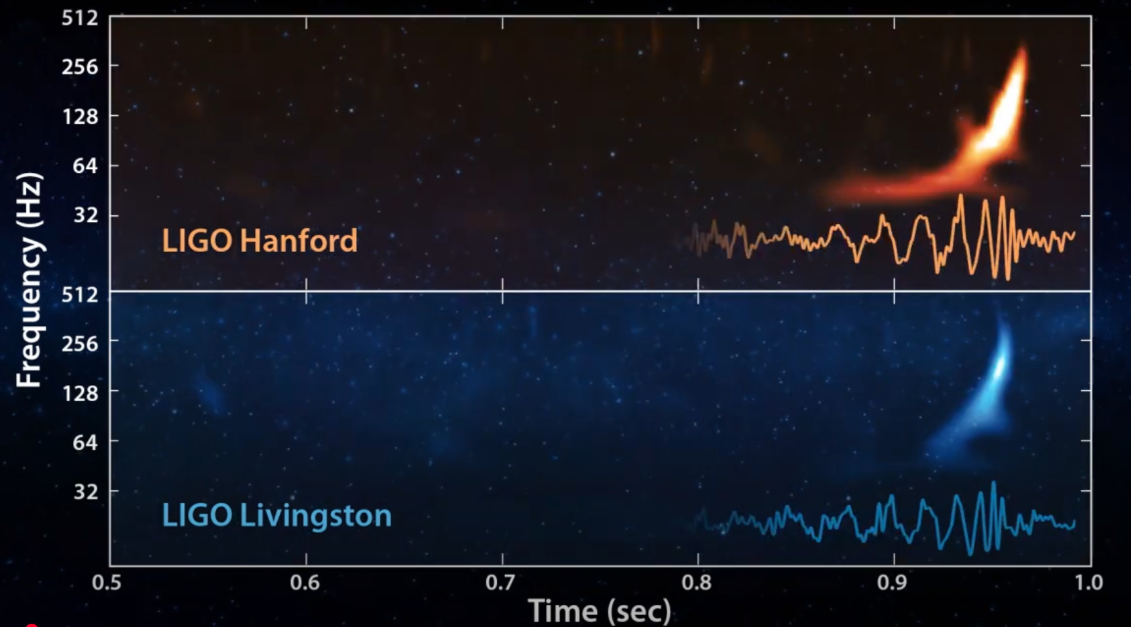
10 years ago, Earth listened
Notes:
https://www.youtube.com/watch?v=I_88S8DWbcU&t=1s

Slide 7
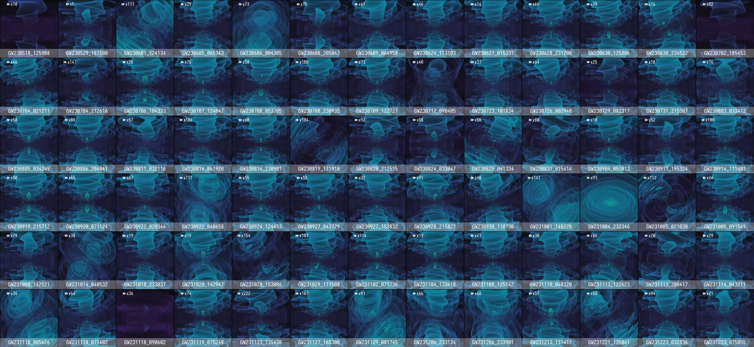
319 detections over 10 years
Notes:
https://www.youtube.com/watch?v=I_88S8DWbcU&t=1s

Slide 8
In ~10 years from now…
Something exciting will happen
Notes:
https://event.surf.nl/national-accelerated-computing-workshop/

Slide 9
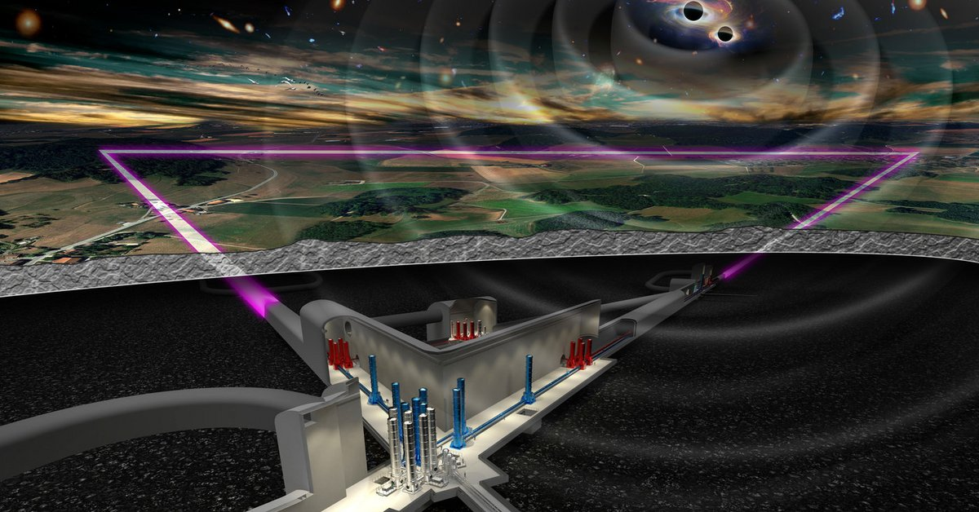
Einstein Telescope:
Europe’s next-gen detector (in NL?)
Notes:
https://event.surf.nl/national-accelerated-computing-workshop/

Slide 10
Einstein Telescope:
Europe’s next-gen detector (in NL?)
~100,000 detections per year!!!
Notes:
https://event.surf.nl/national-accelerated-computing-workshop/

Slide 11
Einstein Telescope:
Europe’s next-gen detector (in NL?)
~100,000 detections per year!!!
Computationally intractable…
Notes:
https://event.surf.nl/national-accelerated-computing-workshop/

Slide 12
Data analysis problem
Analyzing one month of Einstein Telescope data:
~billions/quadrillions of CPU hours!!!
Goal: make our data analysis
Fast (GPUs)
Accurate and flexible (no machine learning)
Easy to use (Python over C/C++, Fortran,...)
Notes:
https://www.youtube.com/watch?v=I_88S8DWbcU&t=1s

Slide 13
The solution?
Easy to use
Fast
Accurate
Notes:
https://www.youtube.com/watch?v=I_88S8DWbcU&t=1s

Slide 14

The solution?
Easy to use
Fast
Accurate
Notes:
https://www.youtube.com/watch?v=I_88S8DWbcU&t=1s

Slide 15

Why ?
jax-ml/jax
Python package: Numpy-like API
Run Python on CPU, GPU, TPU, with 0 code changes
Composable function transformations
jit-compile
Automatic differentiation → scientific computing
Easy parallelization
No emulators/surrogates = no compromises!

Slide 16
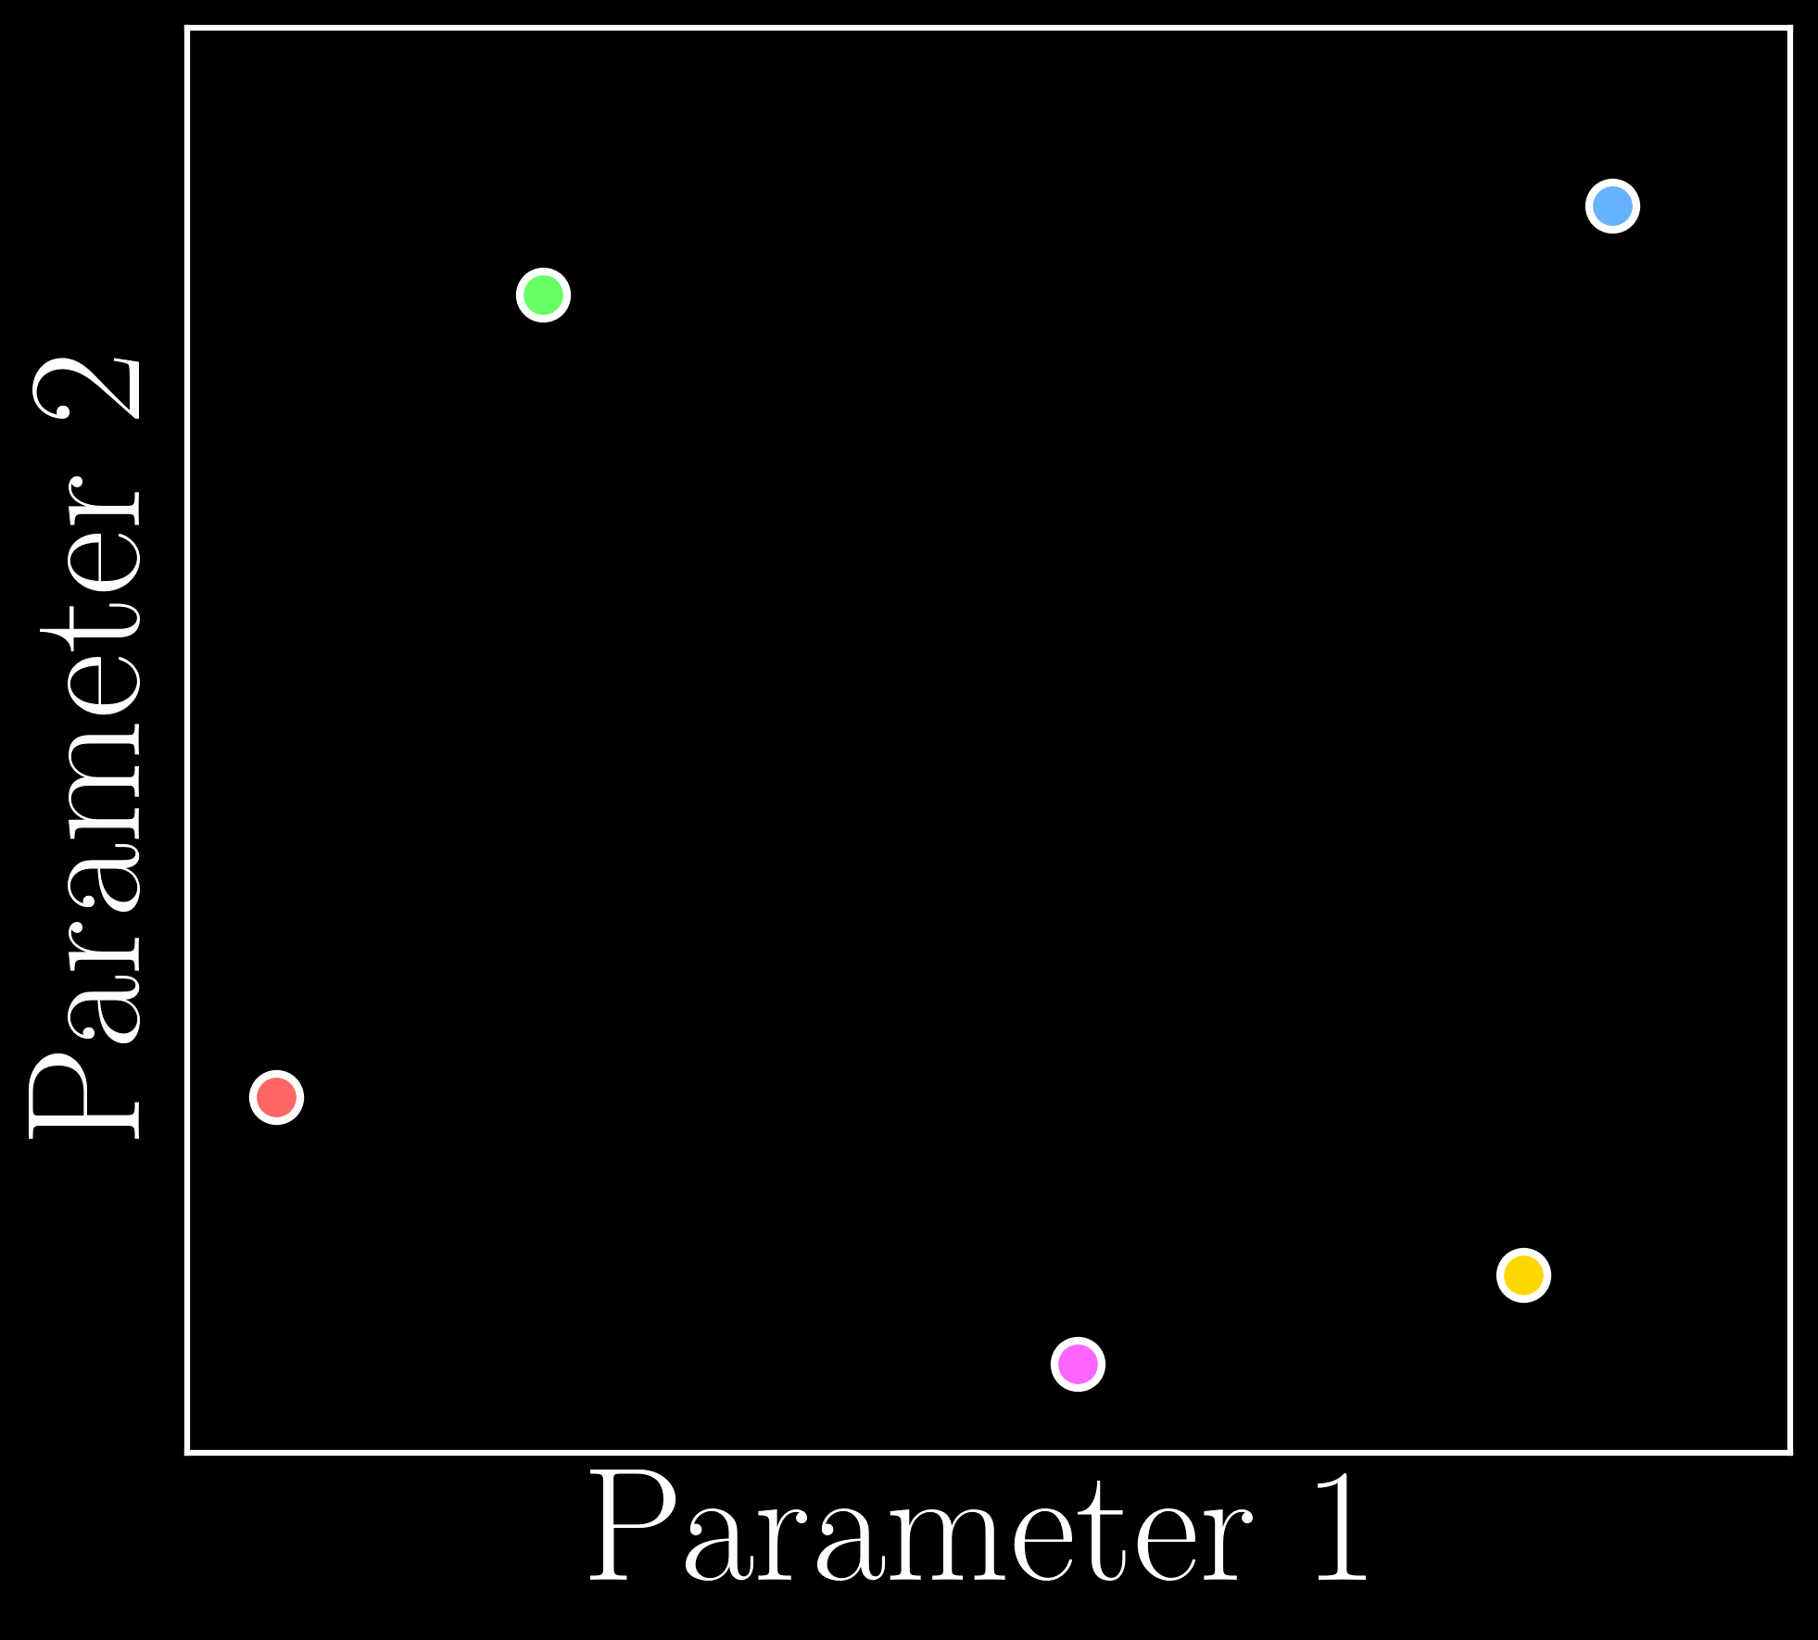
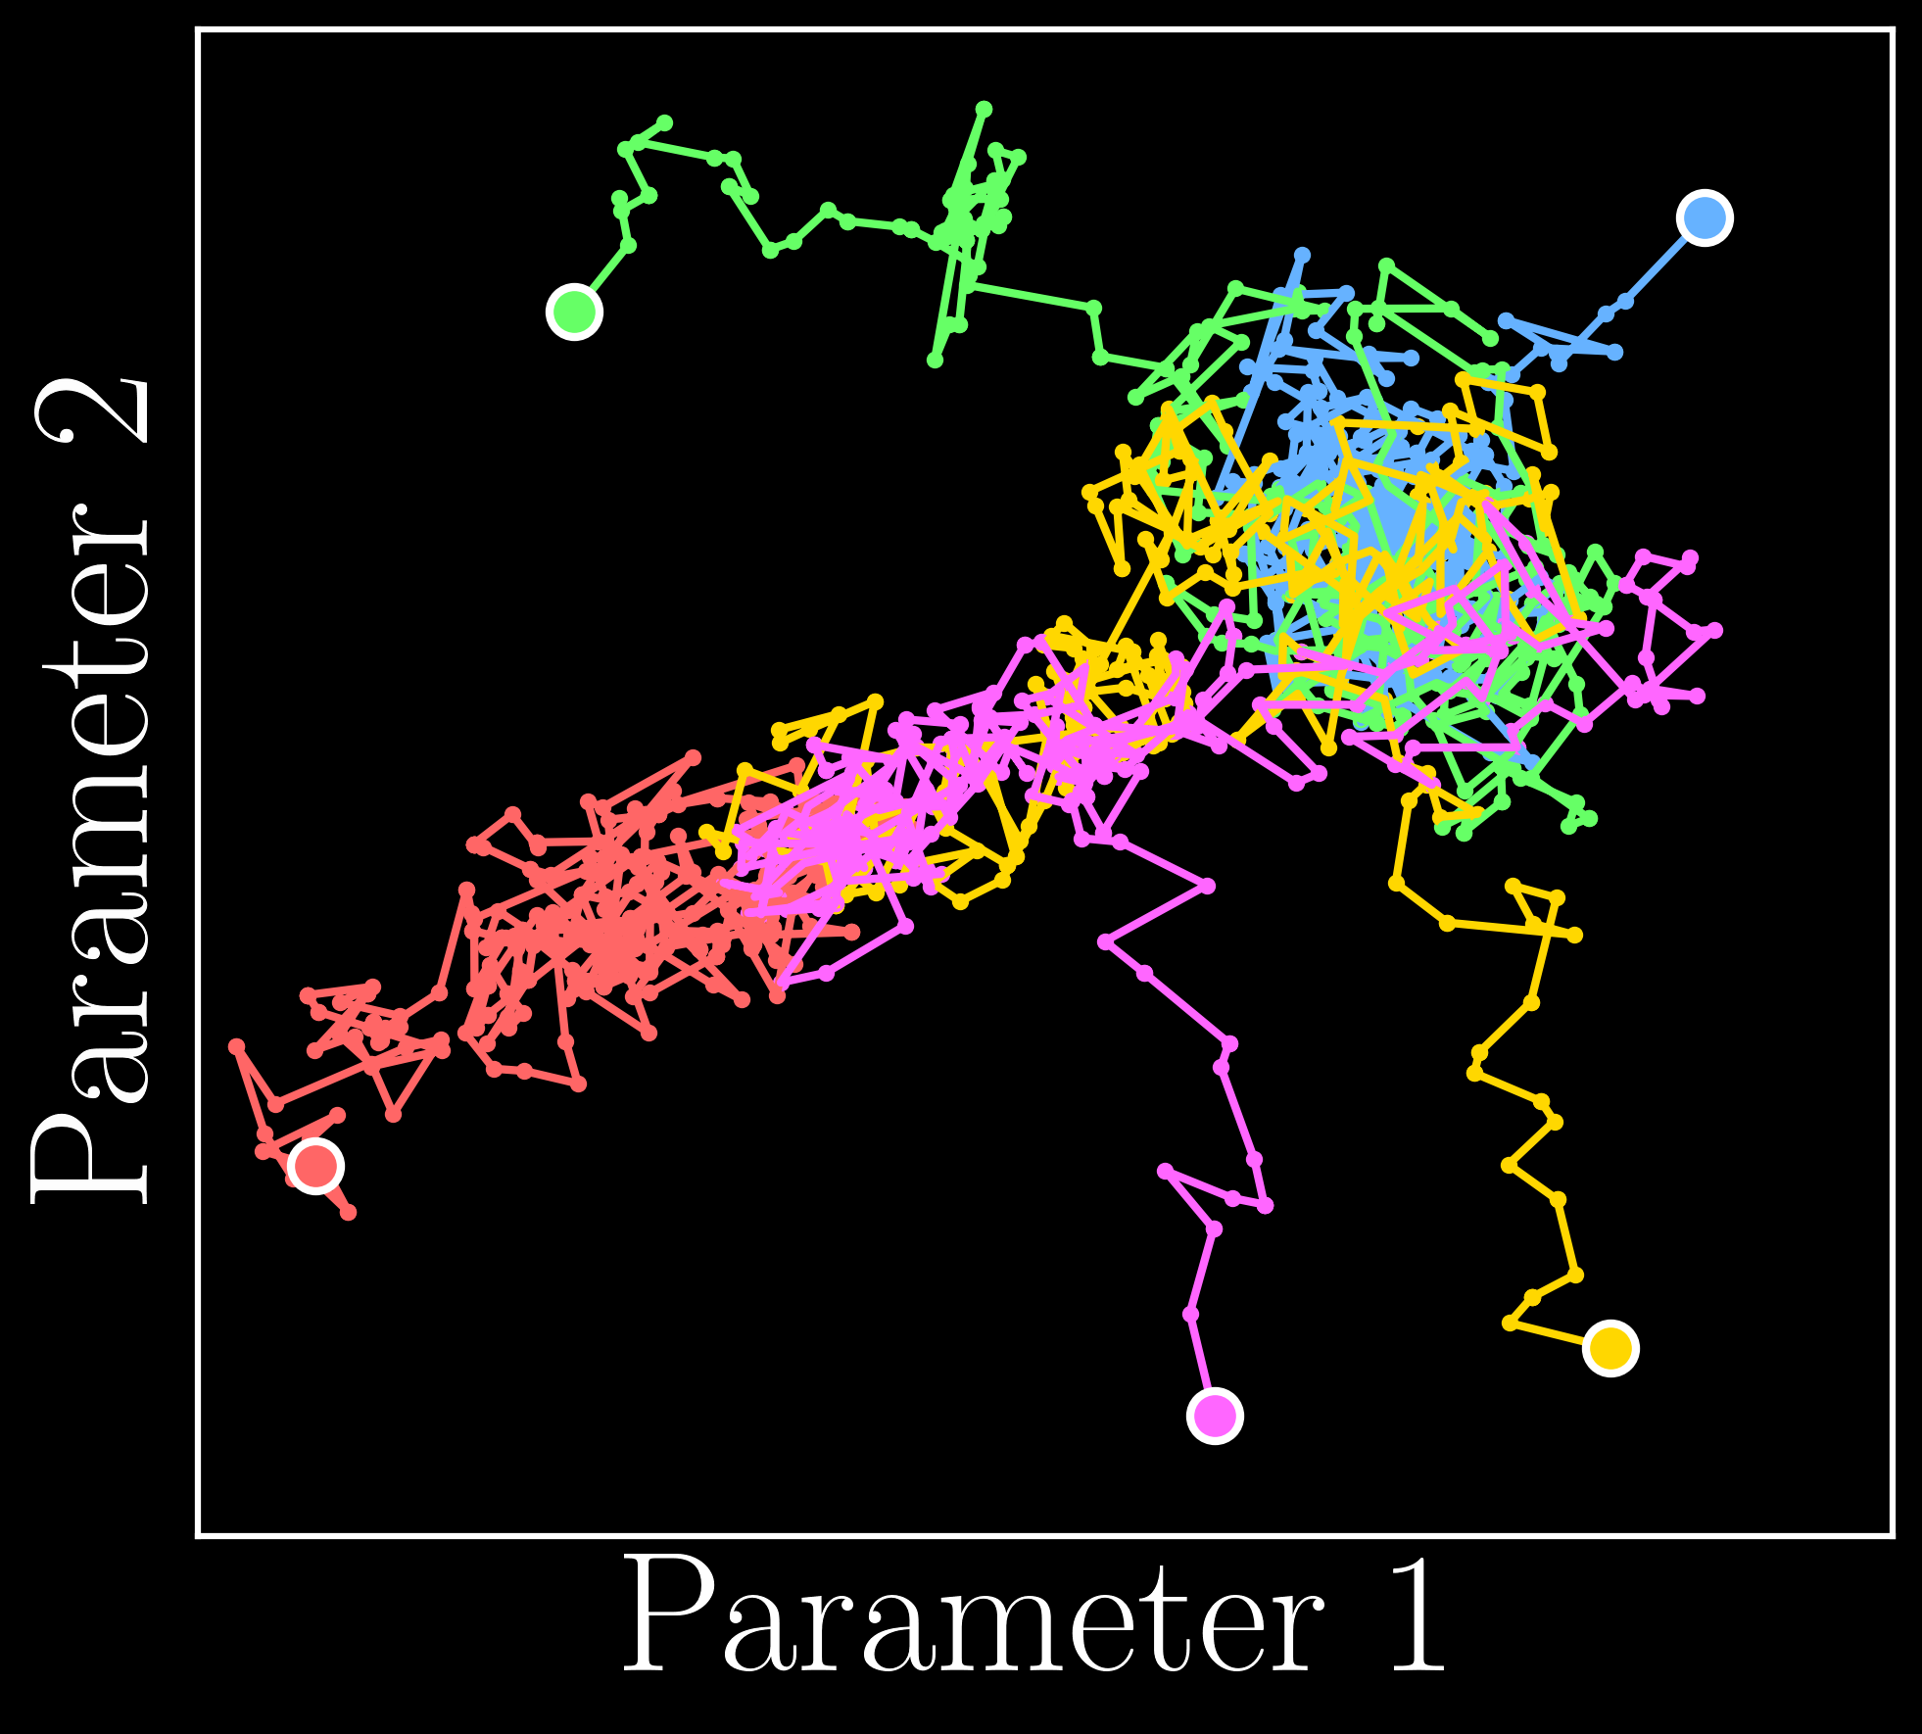
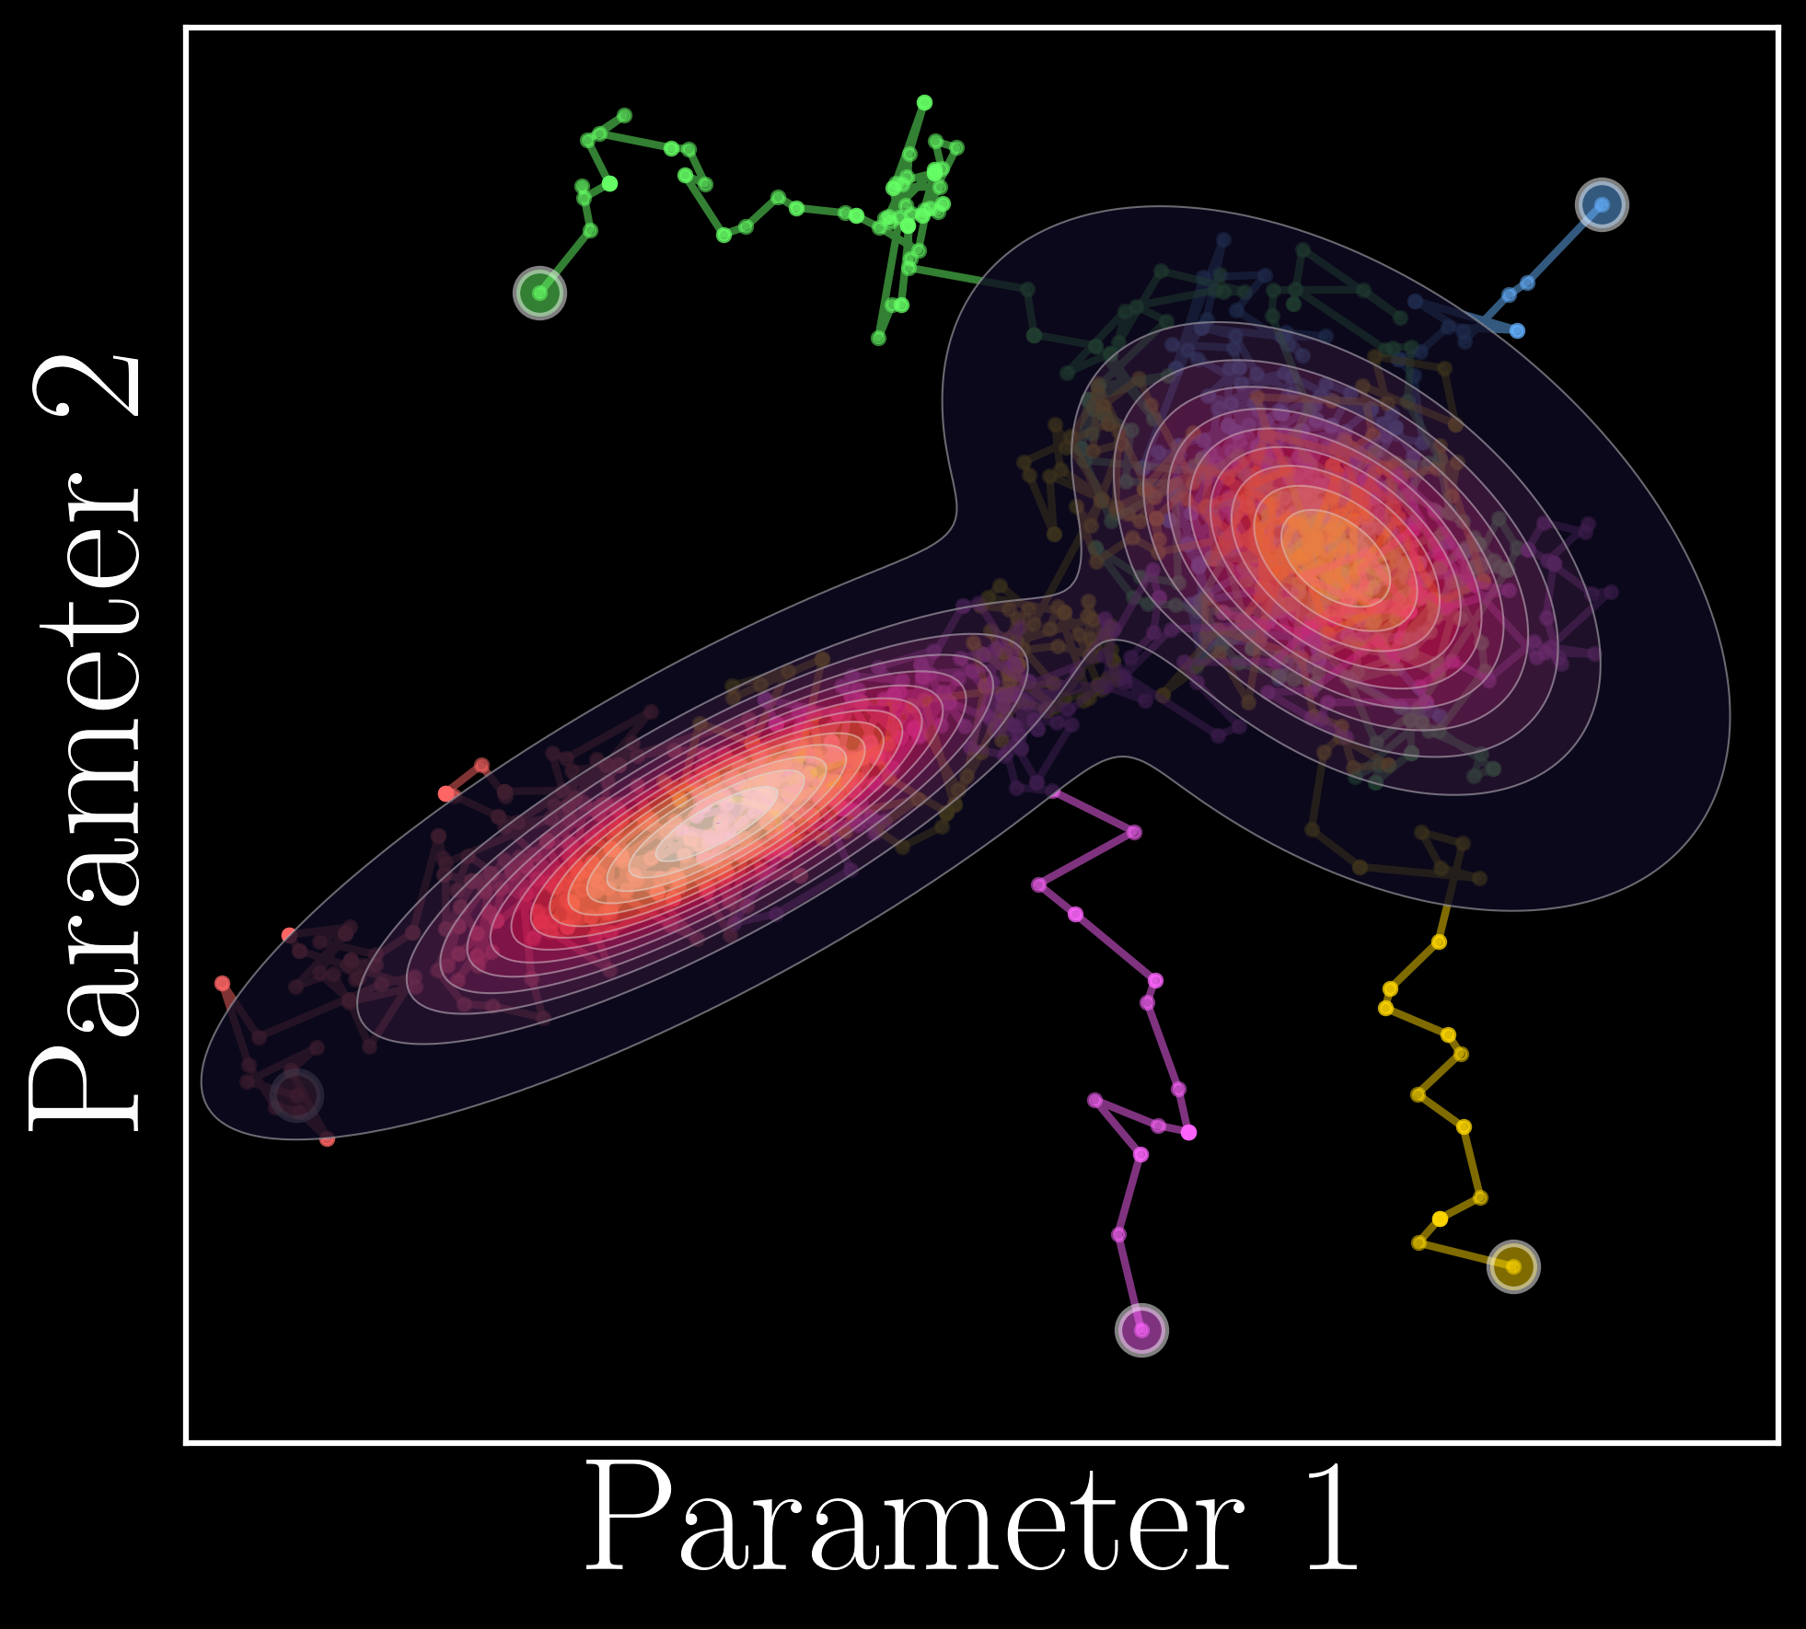
Why for data analysis?
Markov chain Monte Carlo:
→
→
science
→
… is embarrassingly parallel → GPU acceleration

Slide 17
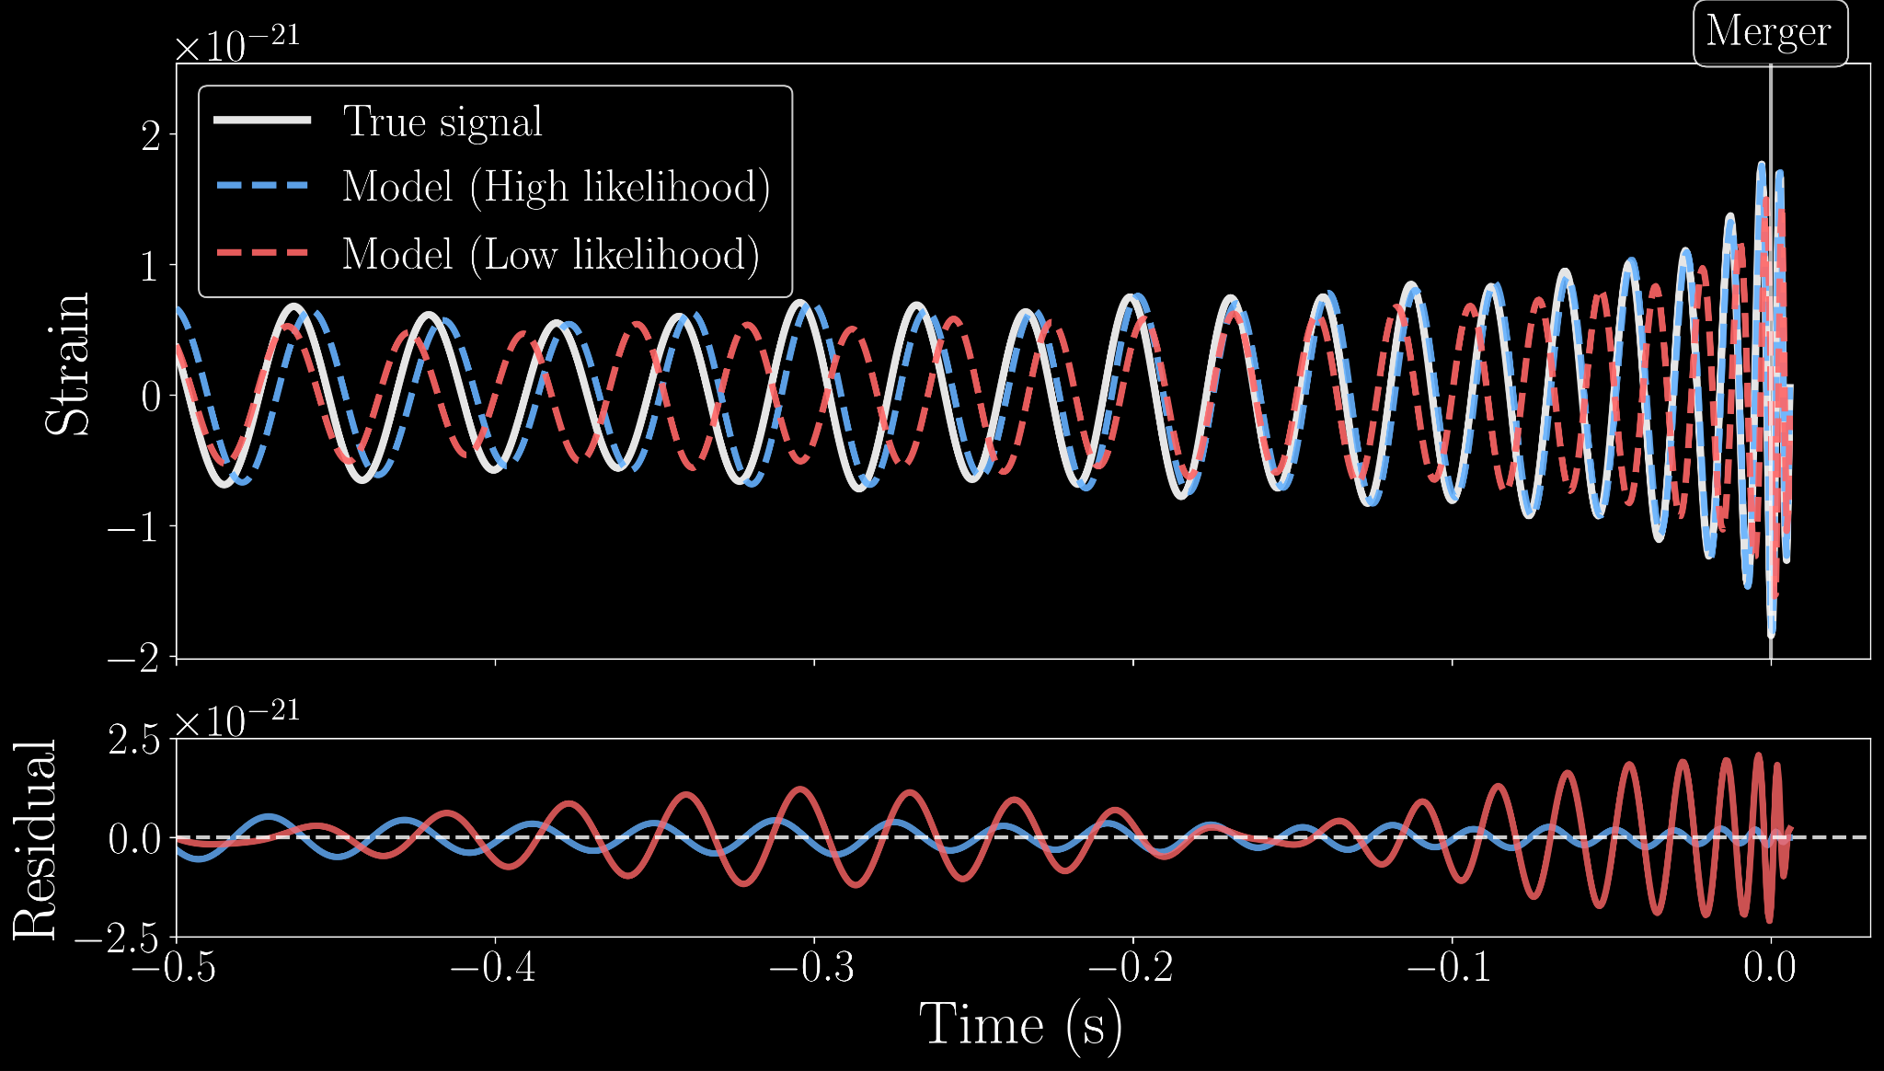
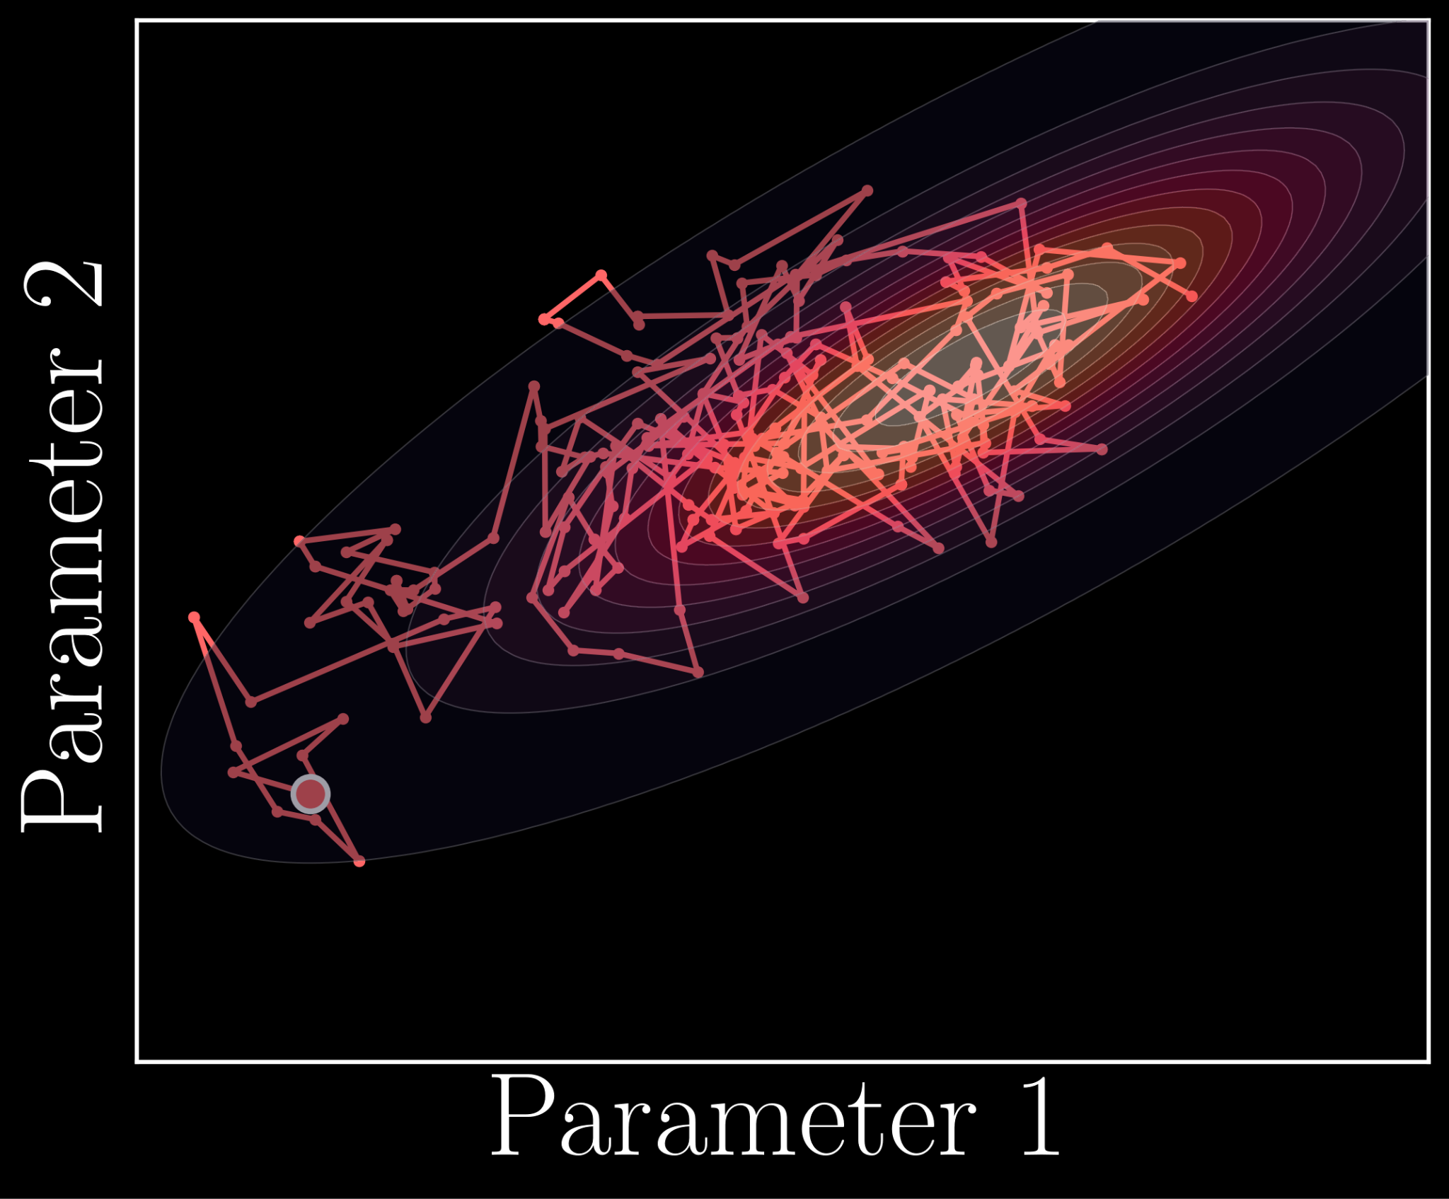
Why for data analysis?
Faster predictions: accelerate evaluation single step

Slide 18


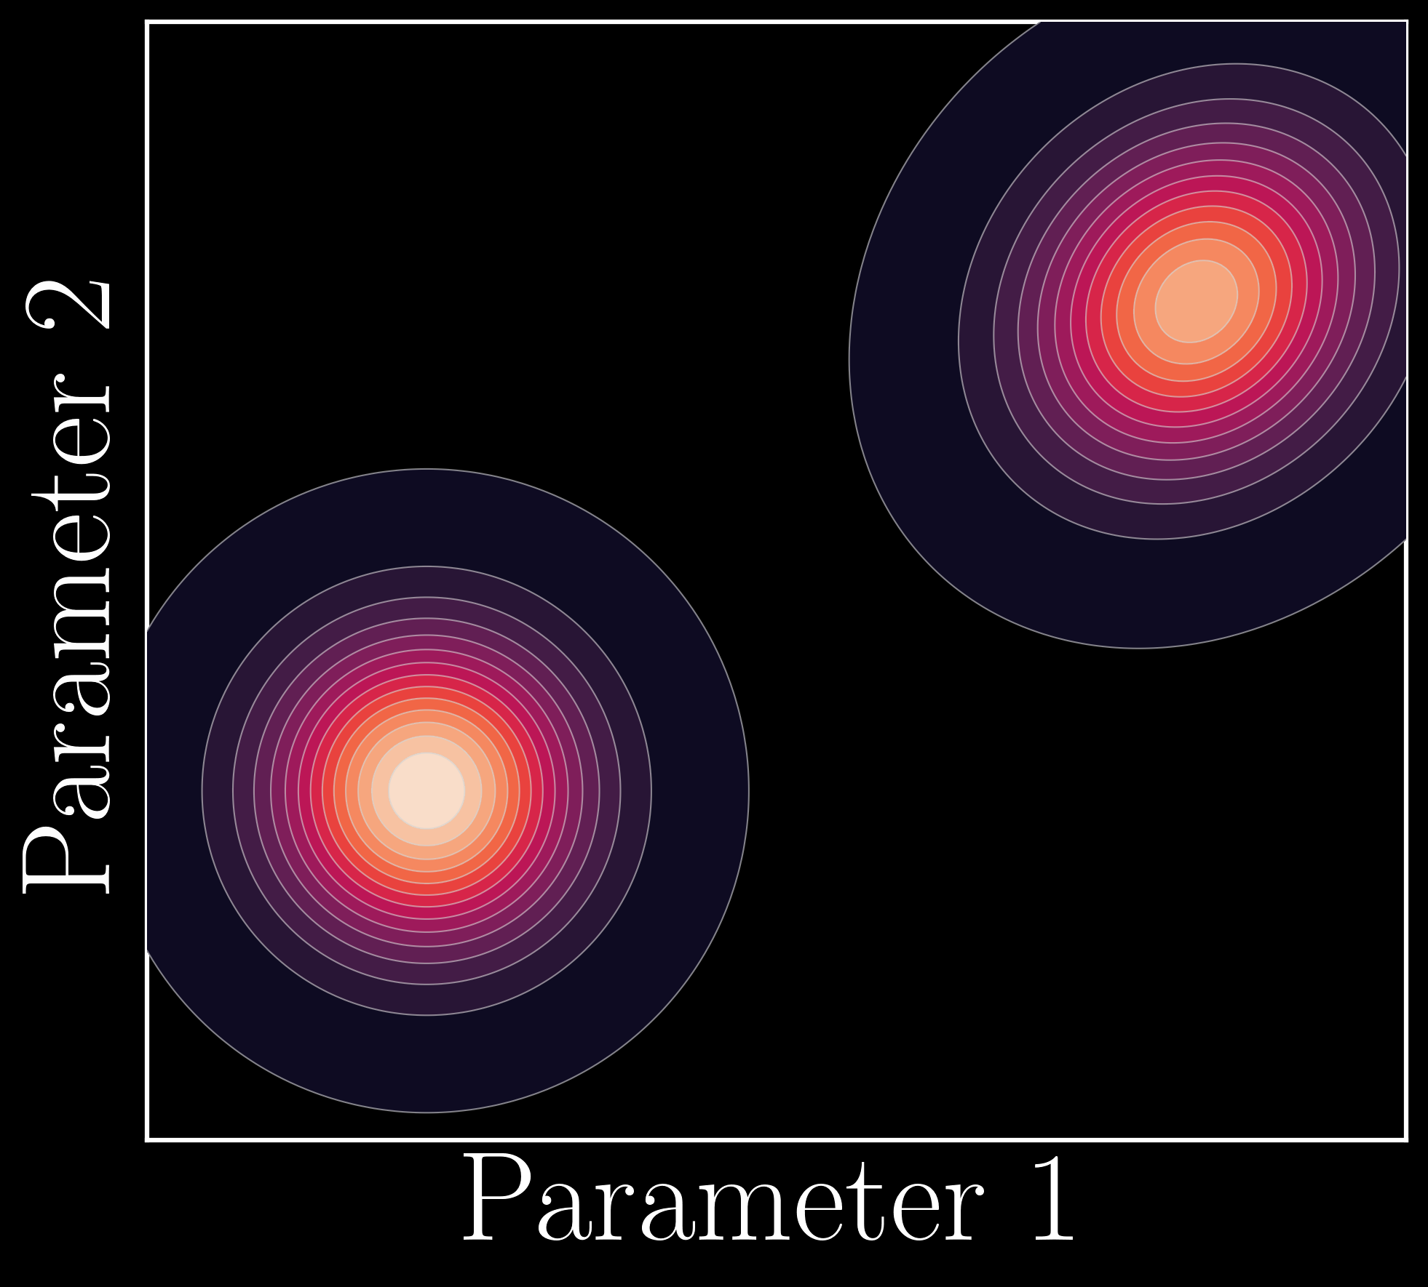
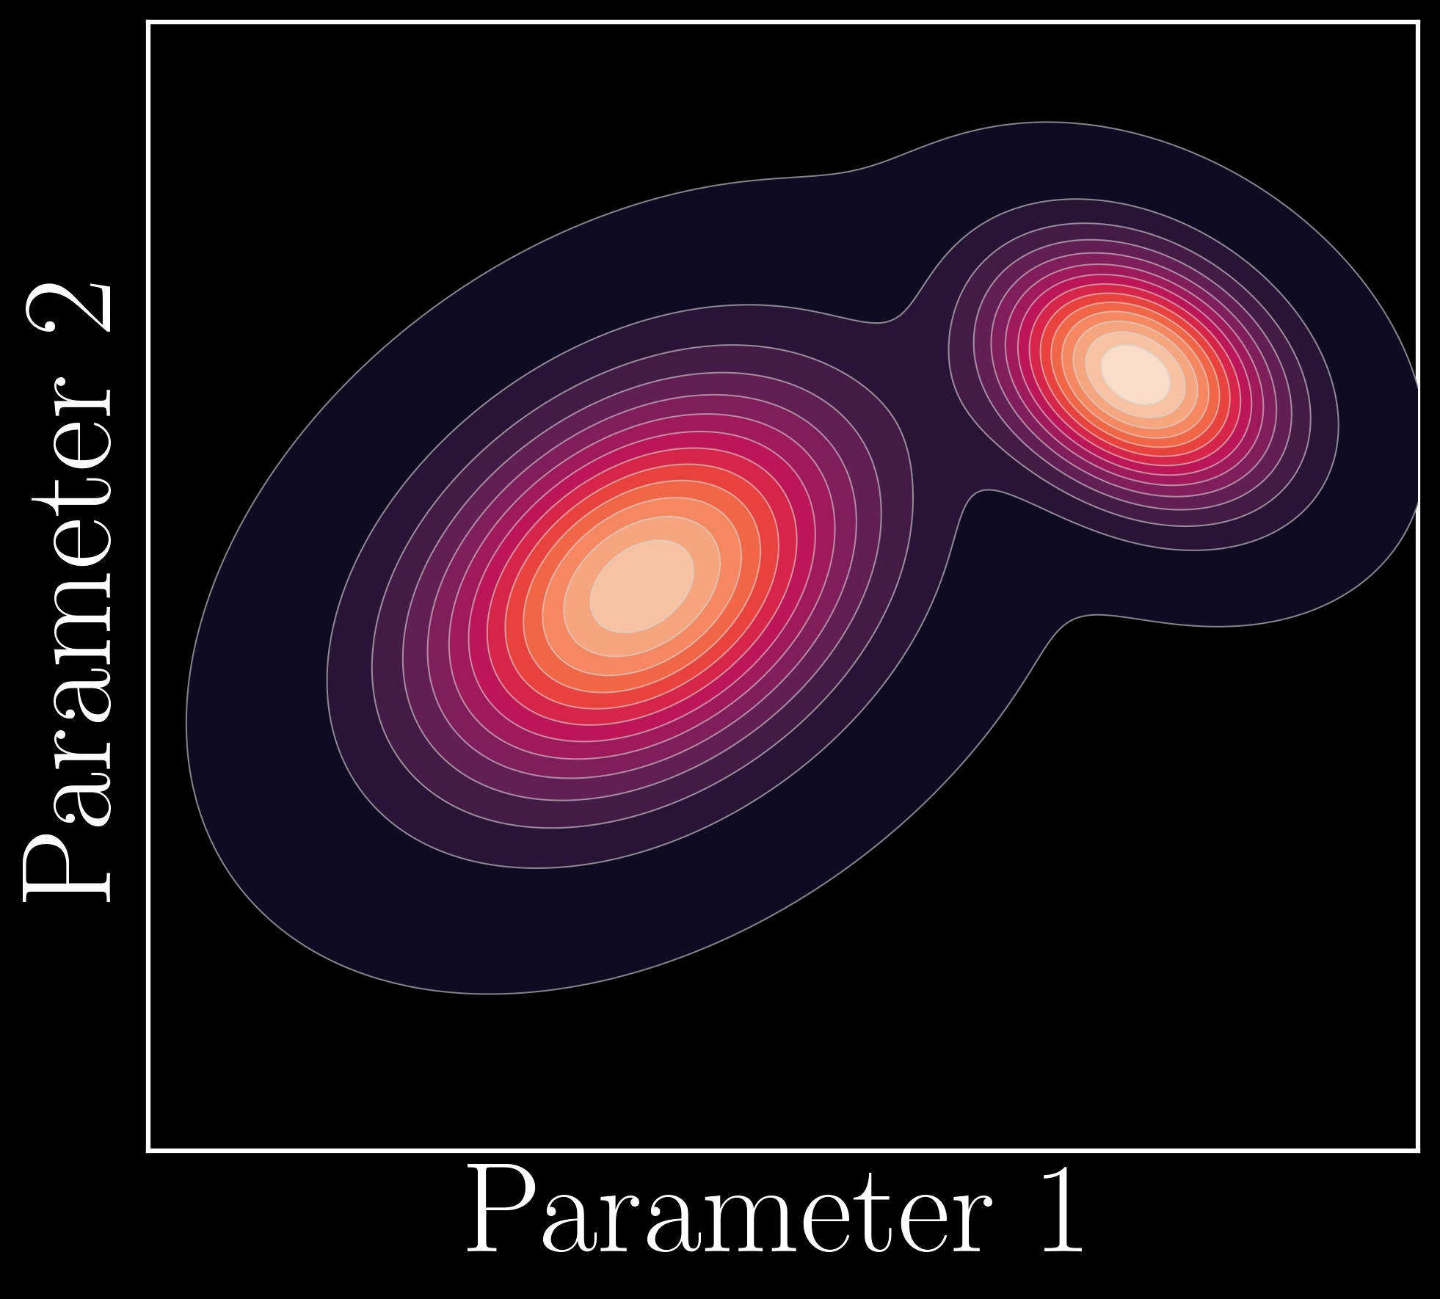
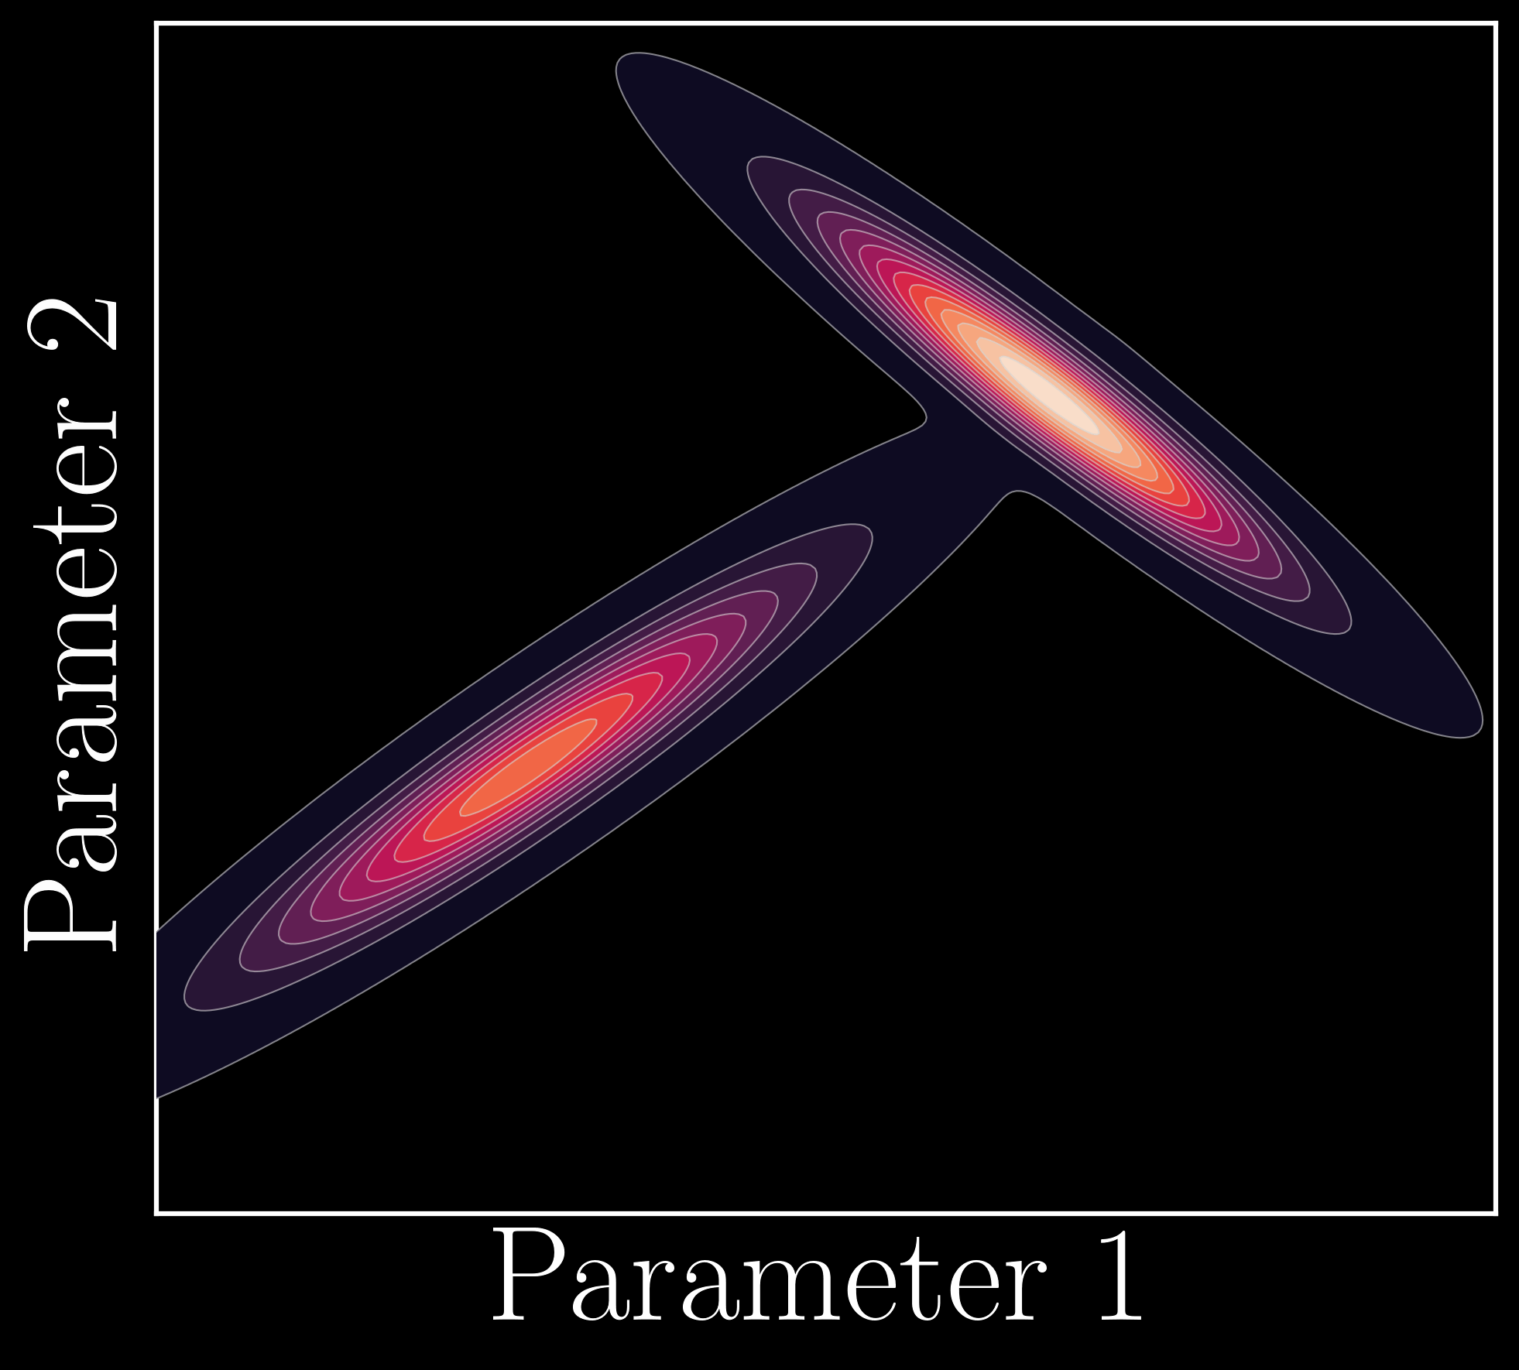
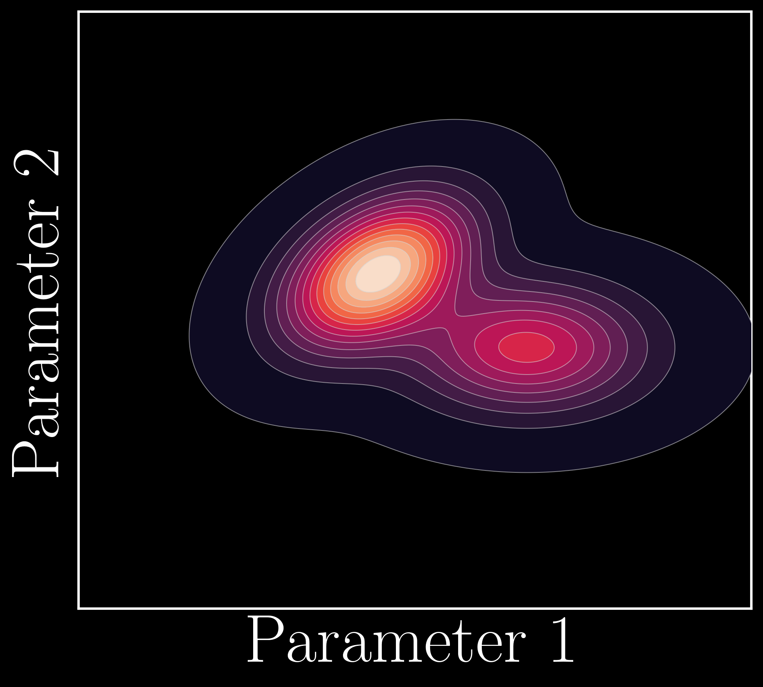
Why for data analysis?
Analyzing gravitational wave data:
→
→
→
→
… is embarrassingly parallel → 1 event = 1 GPU

Slide 19
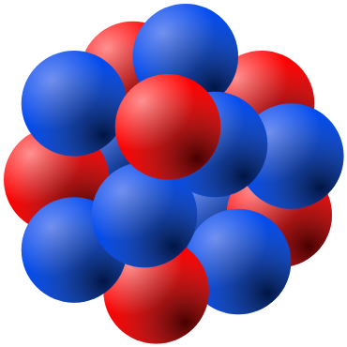
Why for data analysis?
§
Neutron star mergers are unique probes of ultra-dense nuclear matter: again Markov chain Monte Carlo

Slide 20


software developed at
Thomas Ng
github.com/GW-JAX-Team
Me
nuclear-multimessenger-astronomy/jester
Gravitational waves
LIGO: 2 hours → 5 mins (24x faster)
Identical results!
Einstein Telescope: WIP
From neutron star mergers to insights into nuclear physics
Intractable (?) → 1 hour

Slide 21
Conclusions
Notes:
https://event.surf.nl/national-accelerated-computing-workshop/

Slide 22
Conclusions
jax-ml/jax
Gravitational wave data analysis intractable for Einstein Telescope with CPU-based software
JAX: GPU computing made easy
Python-based
Ideal for scientific computing
Accelerate from hours/days to minutes, without compromises
Developed at and tested at Snellius!

Slide 23

Let’s chat!
ThibeauWouters
thibeauwouters
Notes:
https://event.surf.nl/national-accelerated-computing-workshop/

